Slide 1
CSE 10124 Syllabus

Slide 2
Introduction

Slide 3
Introduction: Ice Breaker
What is your name?
What is your favorite AI tool?
What are you most excited to learn in this class?
Notes:
Have students introduce themselves, then TAs, and then instructor

Slide 4
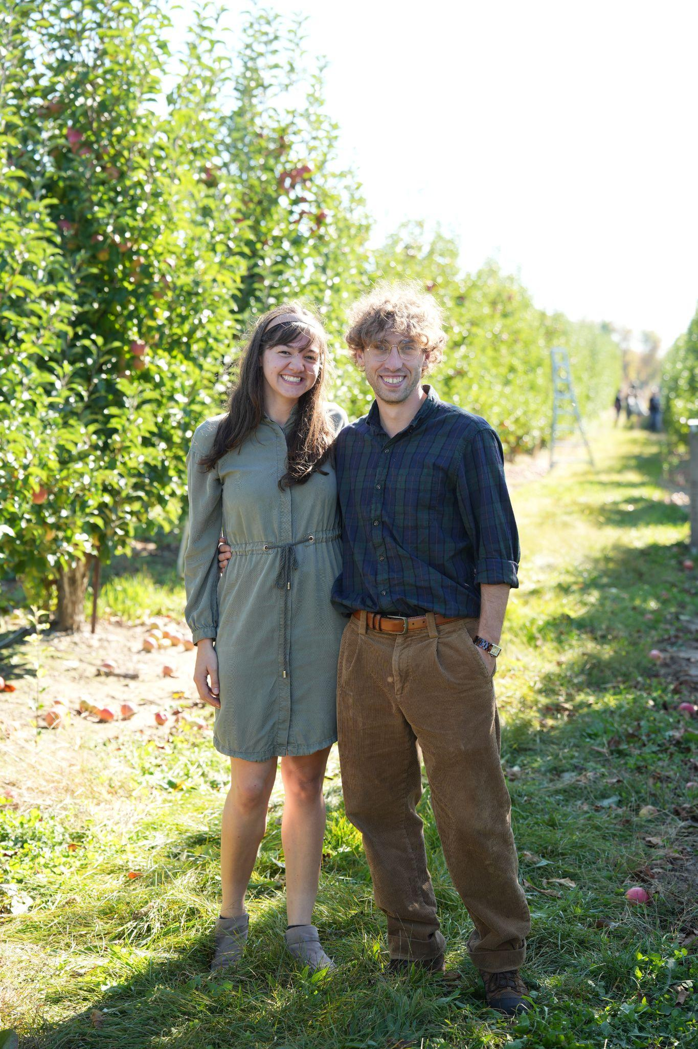

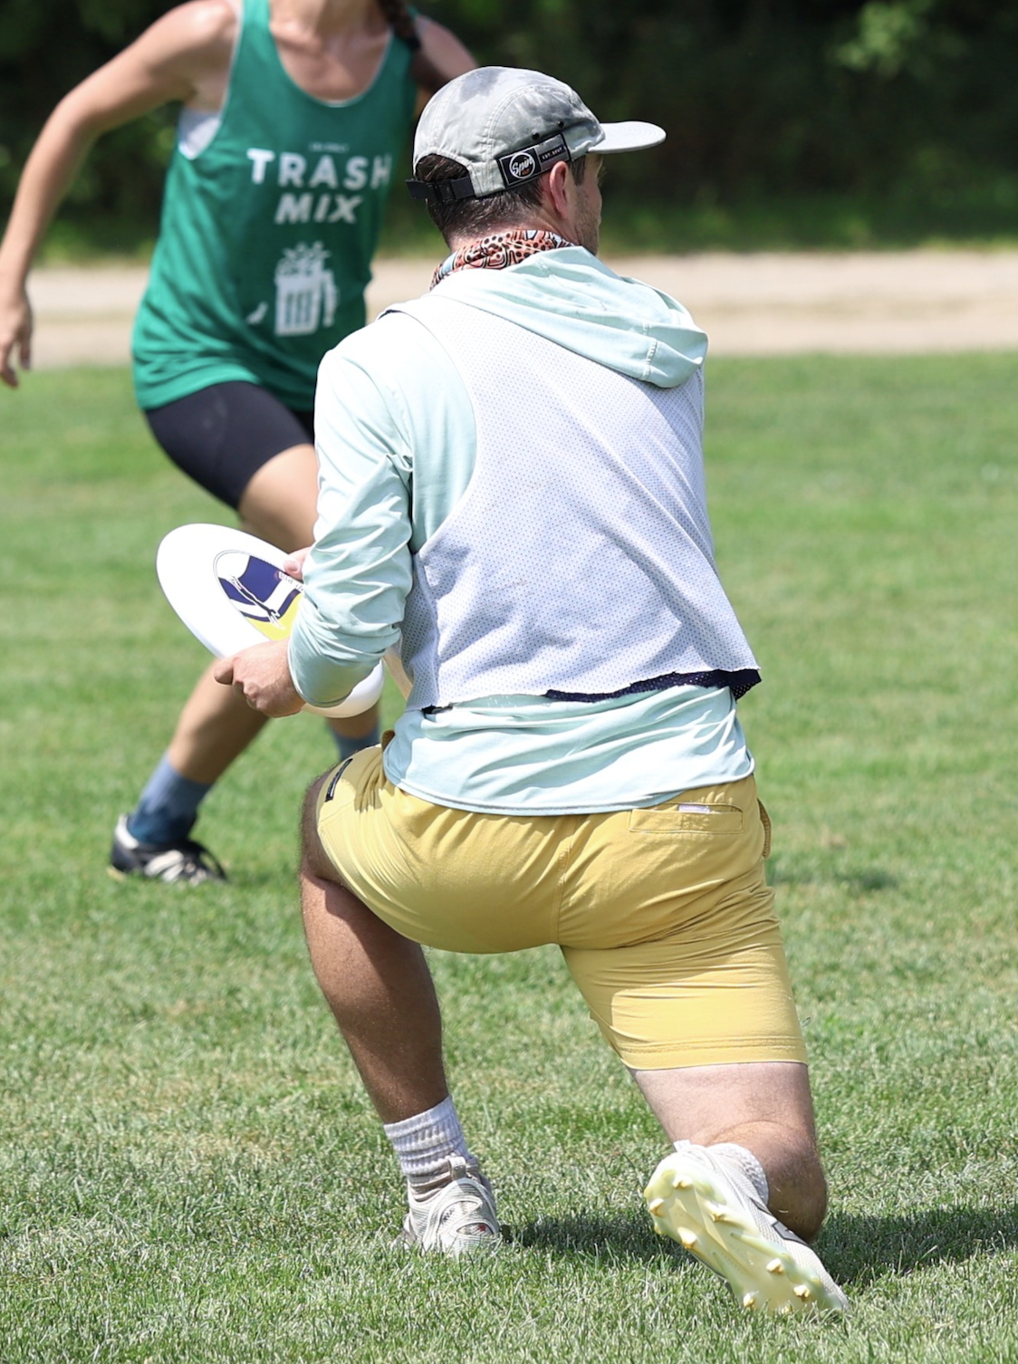
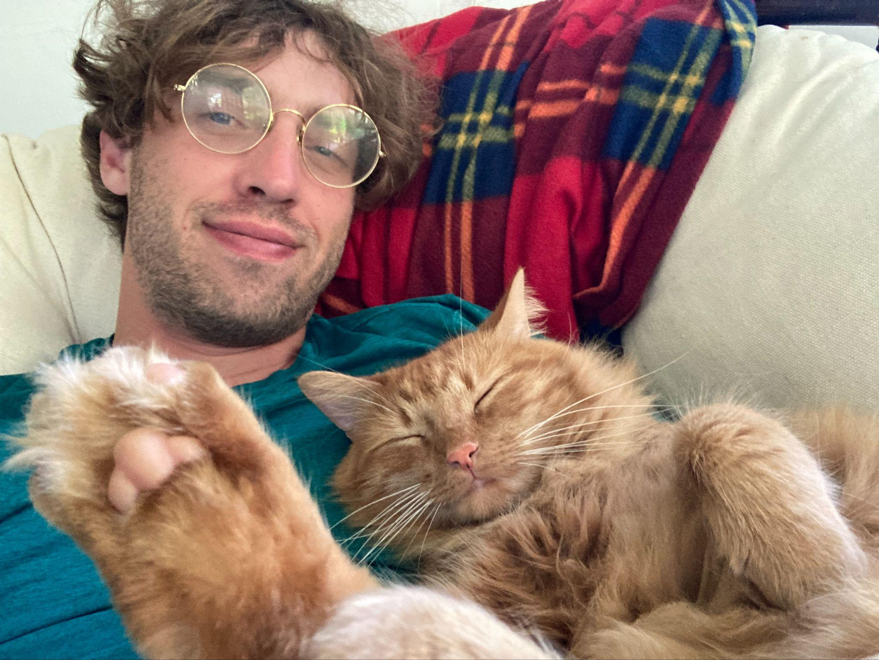
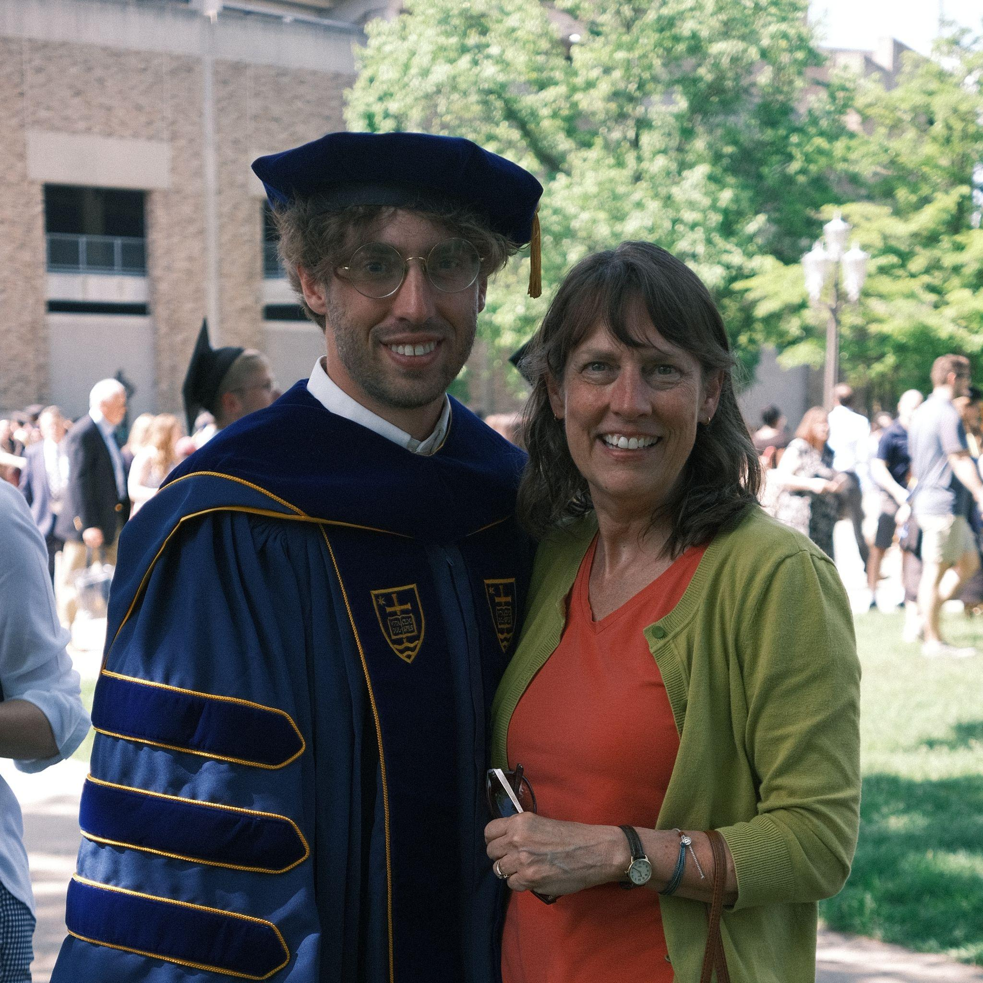
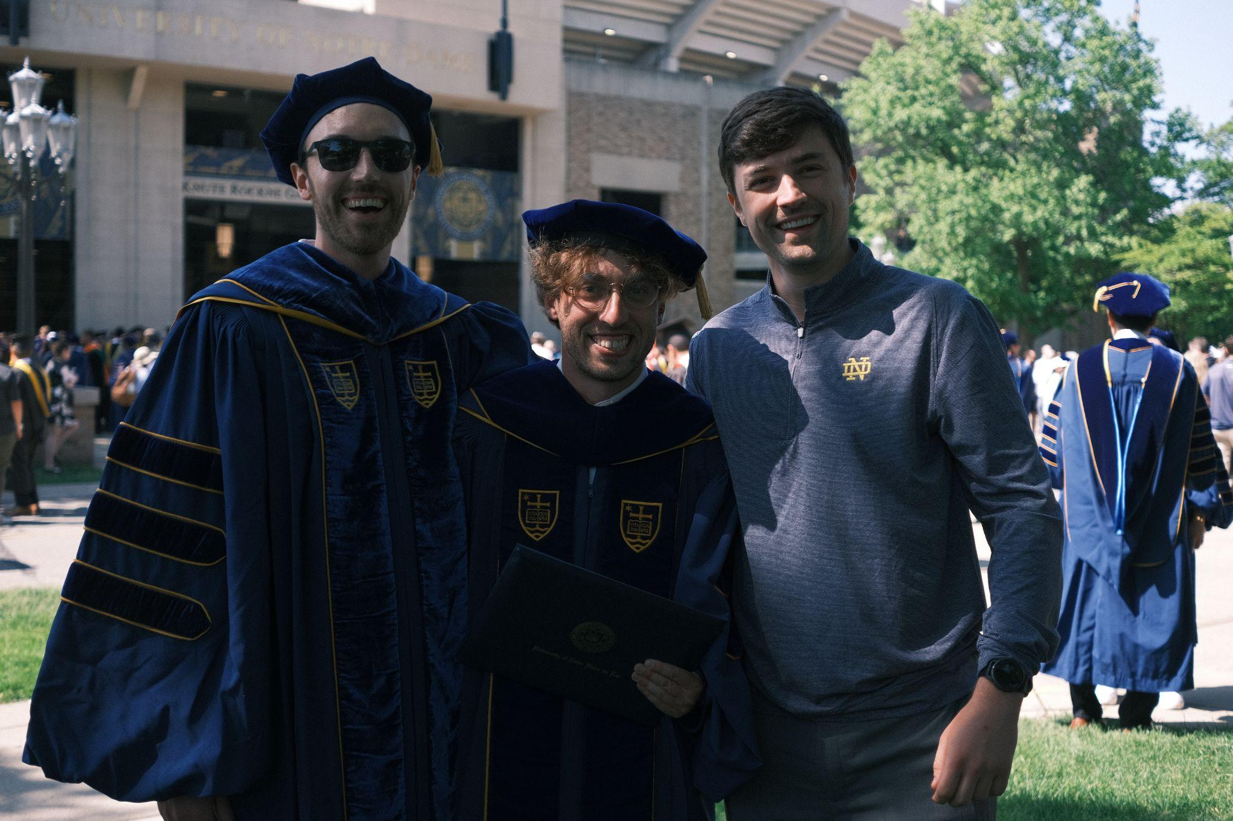
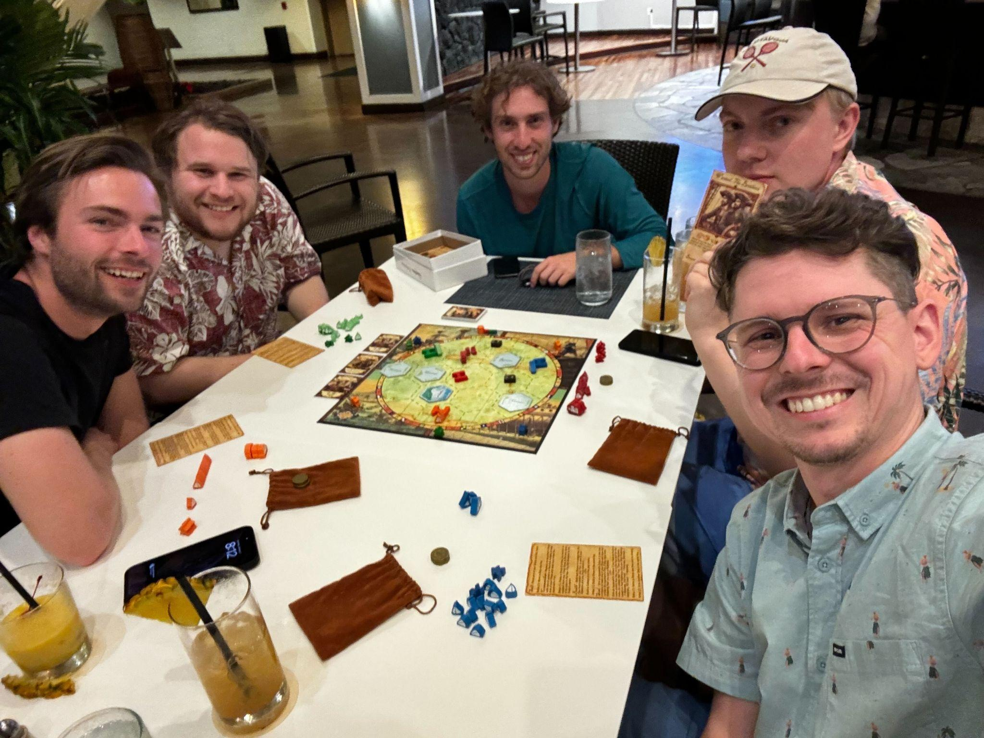

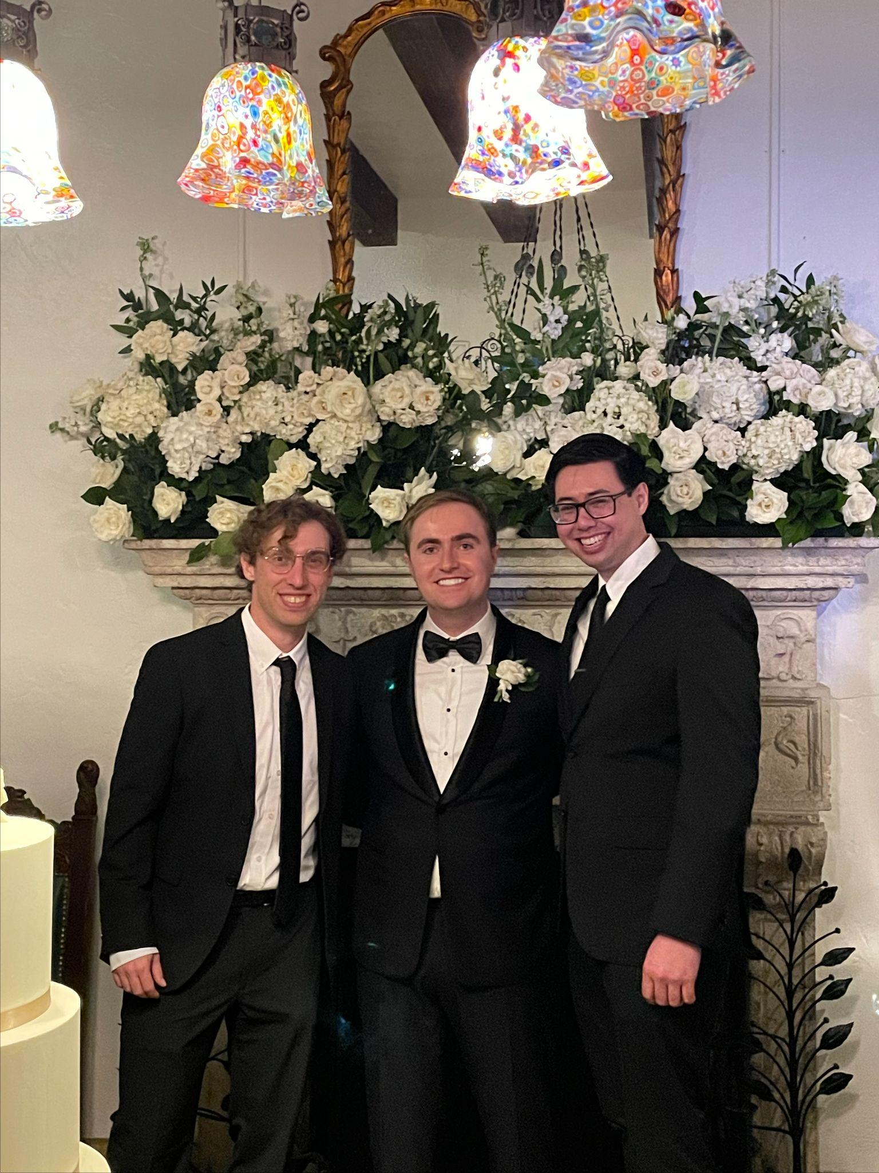


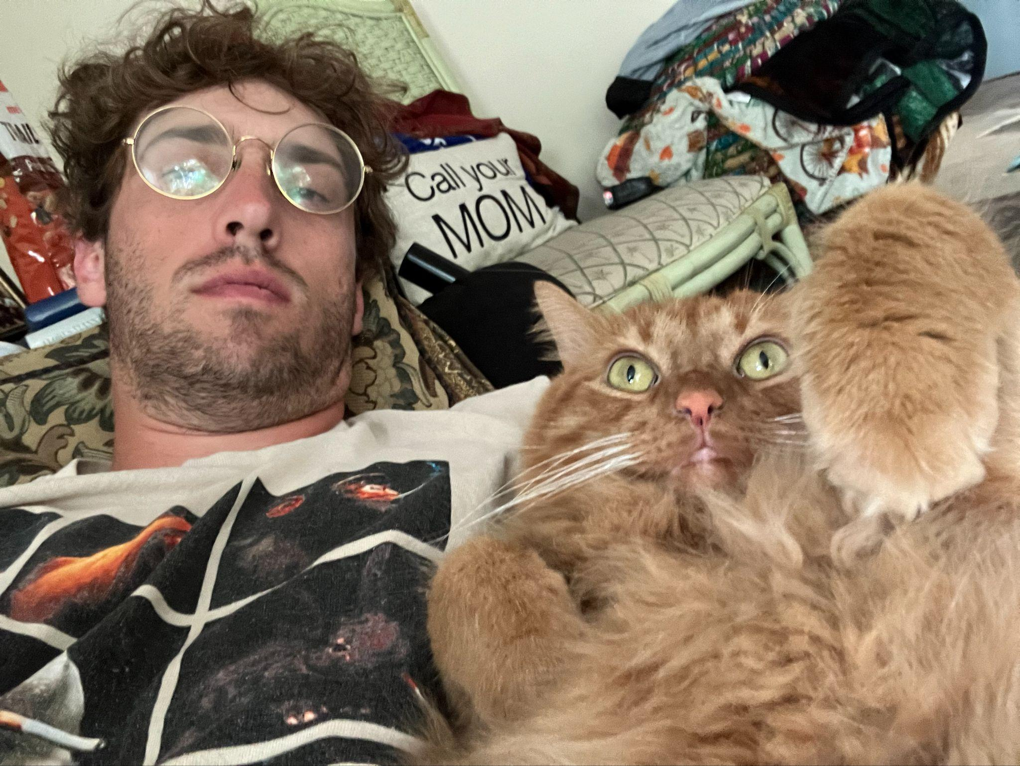

Slide 5
Introduction: Focus of the Course
Cover the history of AI and the algorithms and
methods used when the field was young.
Learn how algorithms learn and the modern
methods of AI (data-driven)
The bonus assignment is creating a version
of chatGPT yourself

Slide 6
Syllabus

Slide 7
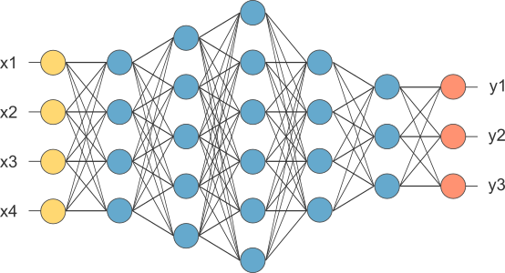
Syllabus: Course Website
All of the course information can be found at:
10124.williamtheisen.com
Additional content can be found at:
ai.williamtheisen.com
Notes:
Show course website

Slide 8
Syllabus: Communication
Slack
#sp26-cse-10124 on Slack

Slide 9
Syllabus: Grading
Components | Points
Code Copies | 5 x 5
Homeworks | 10 x 5
Midterms | 2 x 70
Final | 1 x 85
Total | 300

Slide 10
Syllabus: Assignments
Code and Homeworks are due at midnight.
More info on Thursday

Slide 11
Assignments: Practice Packets
Components | Points
Midterms (10 points for practice packet) | 2 x 70
Final (10 points for practice packet) | 1 x 85
A guided study resource built from slides and old exam questions.
Graded entirely on completion
The points are part of the exam score, not separate!
Due at the exam
Essentially free points for studying

Slide 12
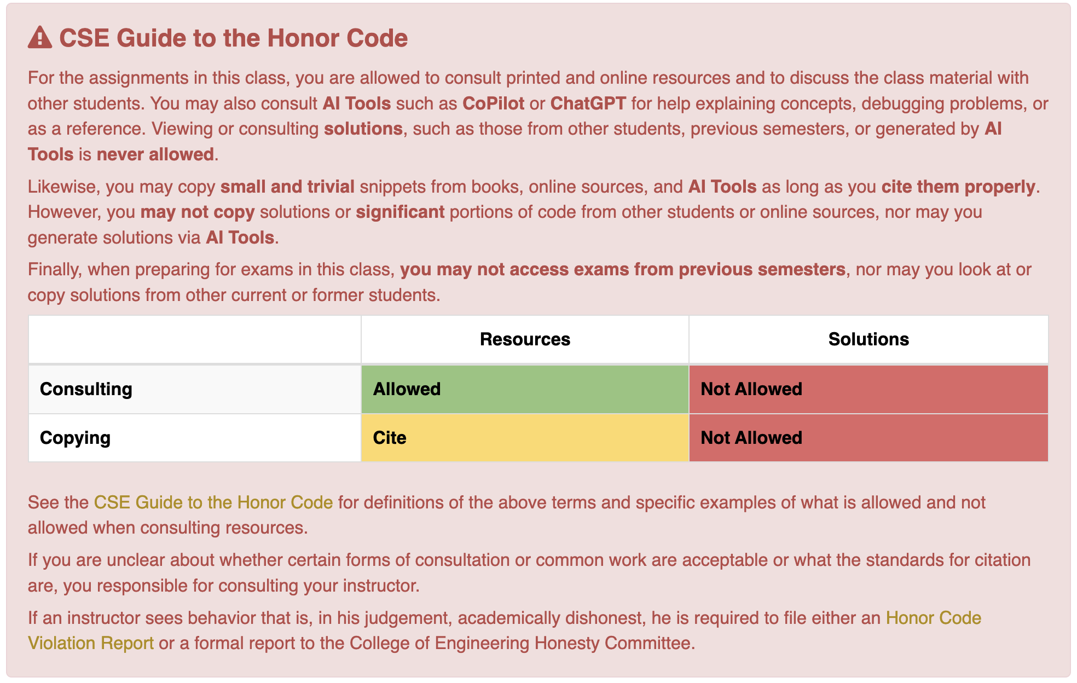
Syllabus: CSE Honor Code
For

Slide 13
Syllabus: The Hacker Ethic
Hackers believe that essential lessons can be learned about the systems—about the world—from taking things apart, seeing how they work, and using this knowledge to create new and more interesting things.
Hackers should be judged by their hacking, not criteria such as degrees, age, race, sex, or position.

Slide 14
Course Structure
Originally we were going to do almost no coding.
However I decided to restructure the course a bit, and now it will be coding centric.
We’re going to build our own LLM line by line

Slide 15
Programming Survey
Please answer the following survey:
https://forms.gle/rksbWoVuRaVaHwg77
This will help me determine the level/amount of programming we’ll need to cover.

Slide 16
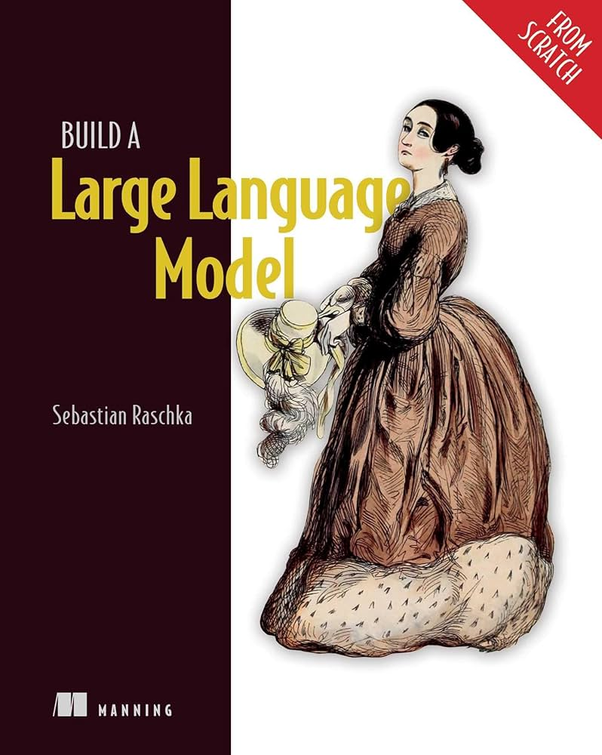
Building an LLM from Scratch
This isn’t a new idea for a course of course.
Github Repo
Youtube Playlist

Slide 17
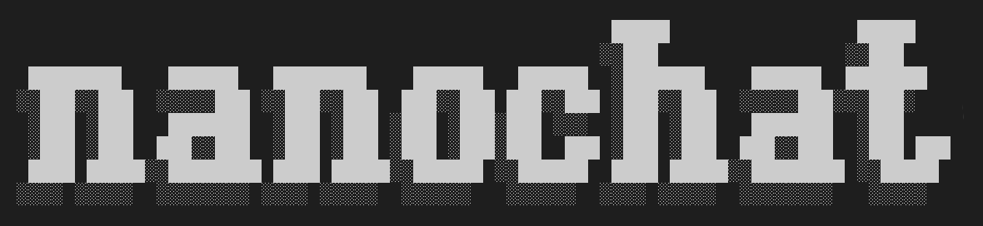
nanochat
We’re going to walk through this repo and rewrite the code line by line.
nanochat is a “small” version of an LLM like chatGPT created by Andrej Karpathy.

Slide 18
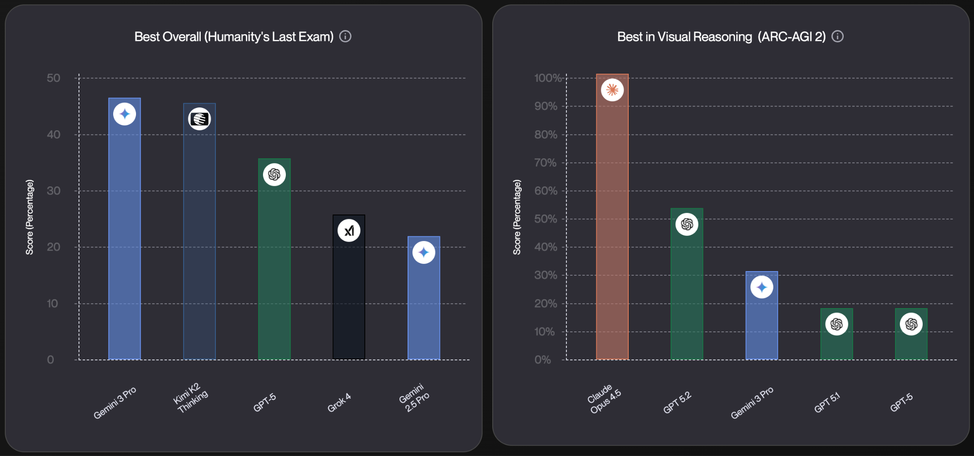
Artificial Intelligence, Currently
Seemingly exponential progress on evals

Slide 19
Trying to stay up to date
It’s nearly impossible to stay up to date, but twitter and the Dwarkesh podcast are what I use mostly.
In the past day we’ve had:
Claude Cowork
Apple signing with Google for new Siri
New Deepseek paper

Slide 20
What is an LLM?

Slide 21
Large-Language Models (LLM)
Language models are a type of generative AI that use natural language processing (NLP) to understand and generate human language.

Slide 22
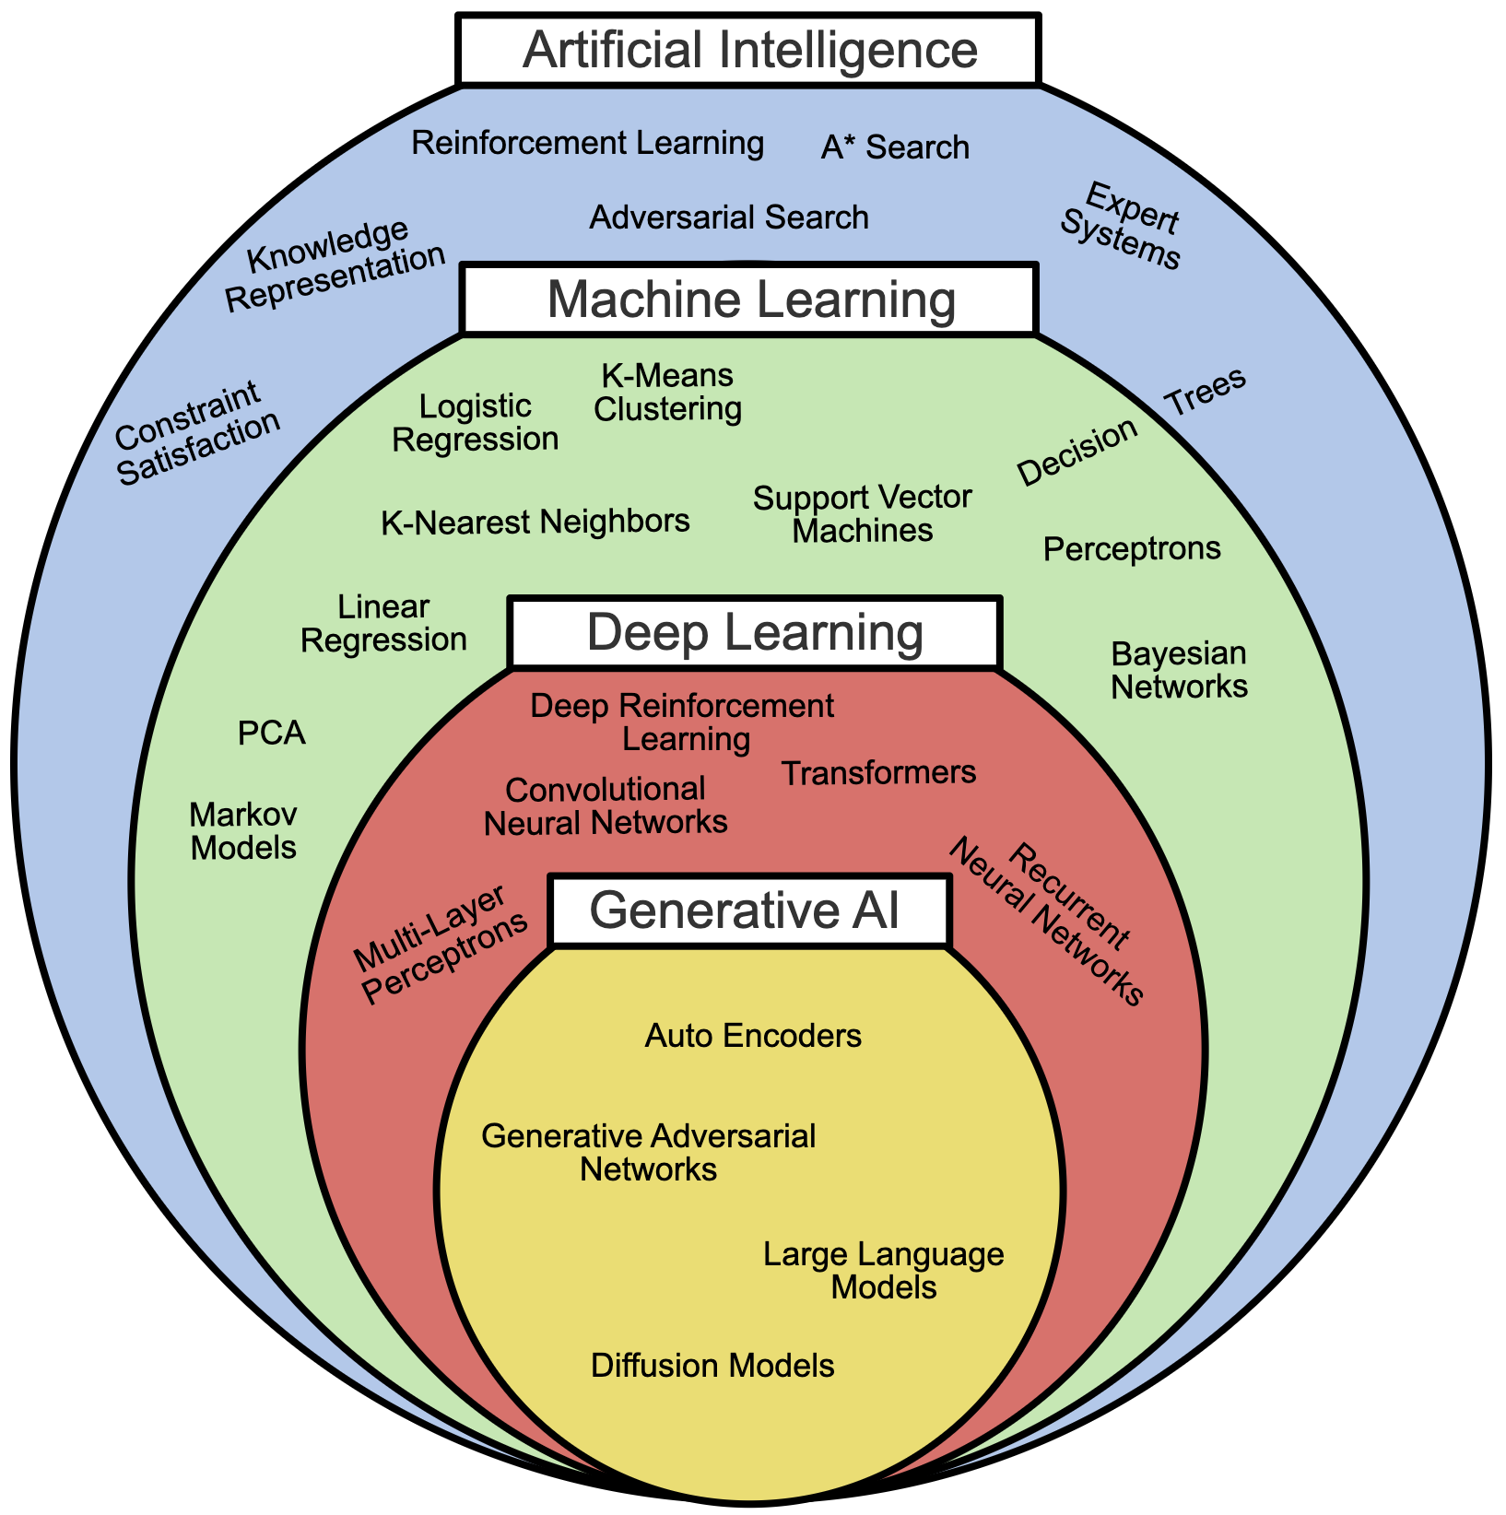

Slide 23
Foundation Models
LLM is a bit of a misnomer for current models. People often instead choose to use the term “Foundation Model” to describe models.
This is because models are no longer just language models, they can operate on a variety of modalities.

Slide 24
Modalities
A modality is just a different type of input.
Common Modalities:
Text
Image
Video
Audio

Slide 25
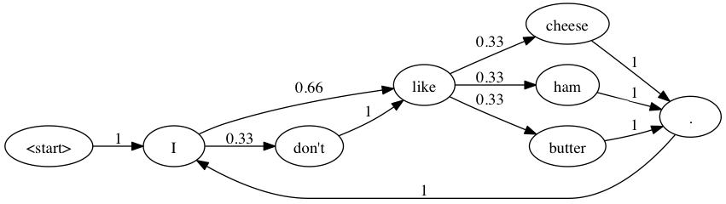
Next Class - Text as Data
How do we learn from text?

